Slide 1
Website Template
http://preview.themeforest.net/item/heaven-hands-responsive-charity-fundraising-wordpress-theme/full_screen_preview/20085285

Slide 2

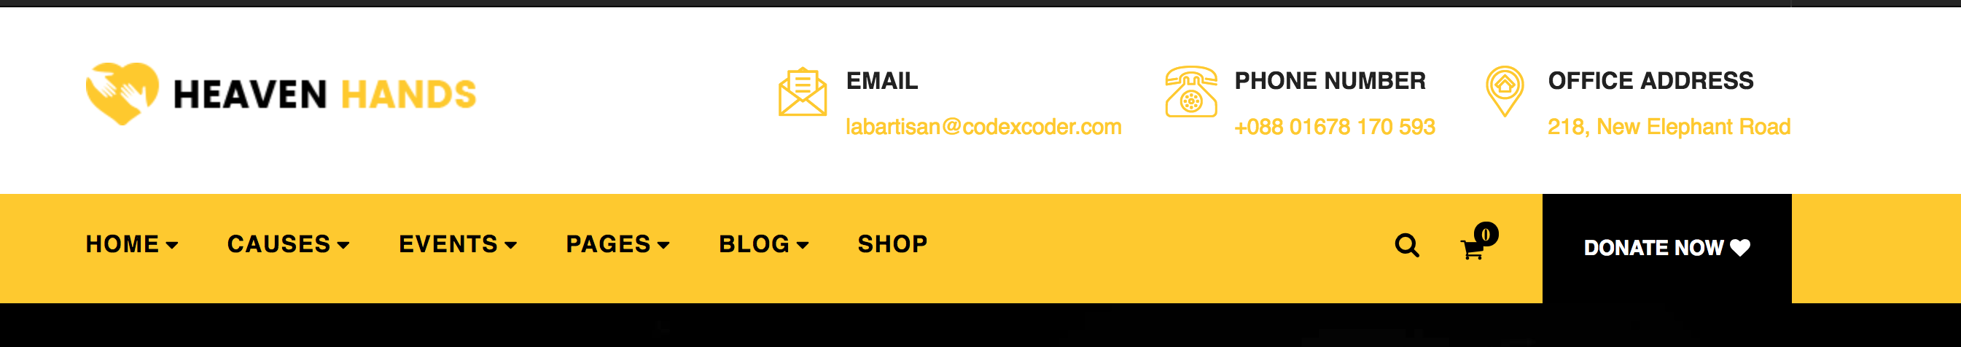
NSBE Boston PCI Logo
NSBE Boston PO Box Address
pci@nsbeboston.org
Delete
Community Resources
Scholarship List
STEM Programs List
AWFE Documents
Donate Button
Amazon Wishlist
Paypal Account
Home
What is PCI
Objectives of PCI
Benefits
STEM Days
What it is
Calendar of Upcoming Days
Contact Us Button
Link to “Contact us Form”
Sign up for Mailing List Button
Events
Calendar of Events
Social Media Links:
FB
IG
Twitter
NSBE Jr Chapters
What is is
List of Chapters
Link to Contact us if want to start chapter

Slide 3

Scrolling carousel of Event Flyers and Pictures

Slide 4

List of blog post (previous events and highlight a NSBE JR member of the month)

Slide 5

Photos from Events. Each tab would take them to pictures from a particular event. Tabs include:
STEM Days
AWFE
NSBE Jr Chapters
Community Events

Slide 6

Pictures of PCI Committee Members. Each members has:
Name, Hometown, Current Profession, Quote about what they like about PCI

Slide 7
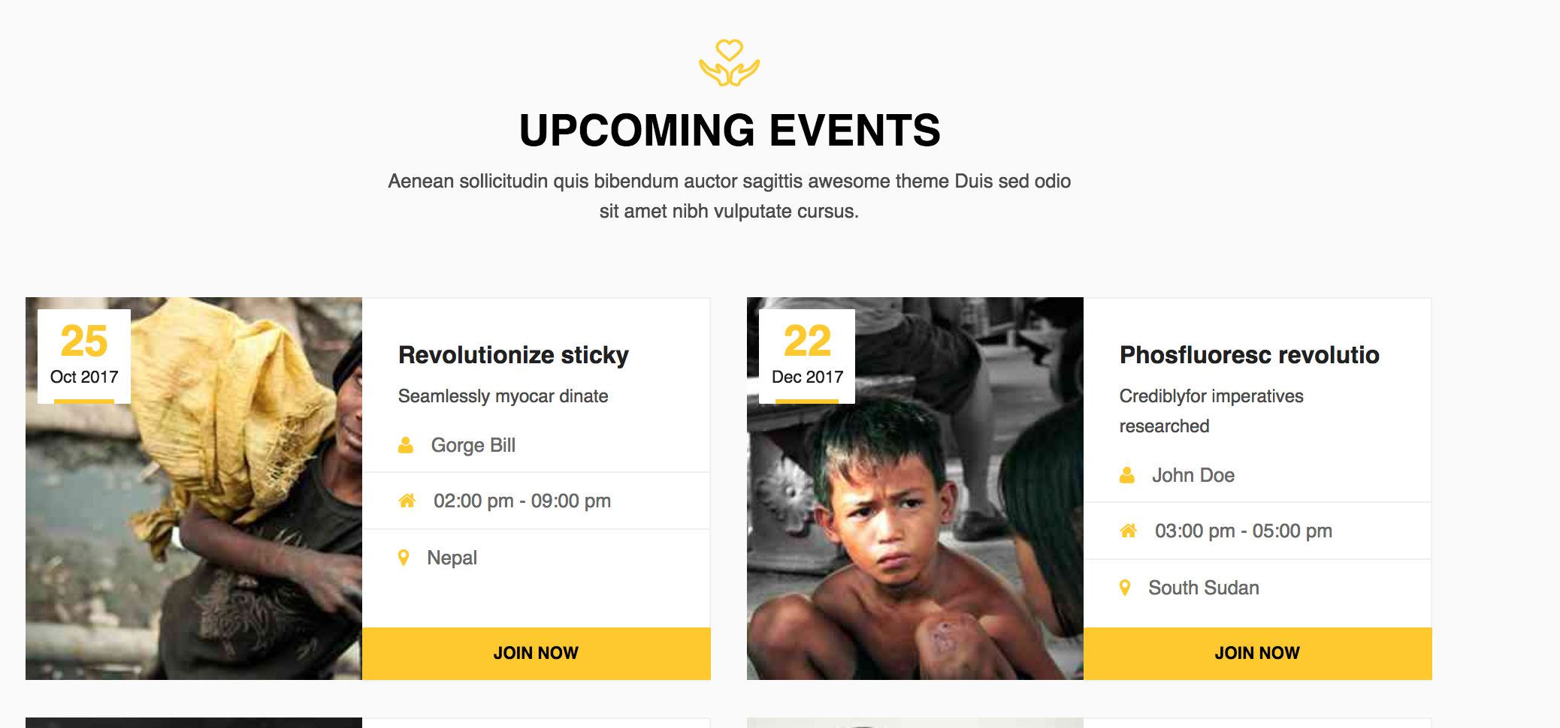
List of upcoming events. The “Join Now” Button will say “Register” and take people to the eventbrite page to register for the event.
Pictures will be event flyers

Slide 8

Testimony and pictures from NSBE Jr Students, Volunteers, Community Members

Slide 9

Name and logos for our PCI Corporate Sponsors & Community partners.

Slide 10

At bottom of page, also include links to FB, IG, Twitter, Email

